Slide 1
Biscuit Sales Analysis
Regional Sales Performance
2024

Slide 2
Dataset Overview
Excel formulas such as XLOOKUP, TEXT, DATEDIF, and arithmetic operators were used to clean data, calculate key metrics, and prepare the dataset for analysis and visualization.

Slide 3
Excel Headers:
  • Transaction Date
  • Buyer Name
  • Location
  • Quantity Purchased
  • Biscuit Brand
  • Total Revenue
  • Profit
  • Profit Margin %

Slide 4
Raw Document: Unibic Orders in San Antonio
Transaction Date | Buyer Name | Location | Biscuit Brand | Quantity Purchased | Total Revenue | Profit
2024-02-29 | Michael Livingston | San Antonio | Unibic | 380 | ₹17,100 | ₹13,300
2024-01-29 | David Barr | San Antonio | Unibic | 94 | ₹4,230 | ₹3,290
2024-03-13 | Rita Jacobs | San Antonio | Unibic | 99 | ₹4,455 | ₹3,465
2024-04-18 | Holly Fields | San Antonio | Unibic | 97 | ₹4,365 | ₹3,395
2024-03-28 | Katherine Abbott | San Antonio | Unibic | 71 | ₹3,195 | ₹2,485
2024-05-04 | Samuel Jordan | San Antonio | Unibic | 422 | ₹18,990 | ₹14,770
2024-06-12 | Cheryl Goodman | San Antonio | Unibic | 62 | ₹2,790 | ₹2,170
2024-05-28 | Melissa Jones | San Antonio | Unibic | 120 | ₹5,400 | ₹4,200

Slide 5
Raw Document: Buyer Demographics & Data Cleaning
Buyer Name | Age Group | Gender | Payment Method | Location
Allen Santos | 59-68 | Other | Credit Card | San Antonio
Brenda Shaw | 69+ | Male | Debit Card | San Jose
Robert Hernandez | 69+ | Female | Cash | Philadelphia
Alexander Smith | 29-38 | Male | Debit Card | San Antonio
Mary Rodriguez | 49-58 | Other | Credit Card | San Jose
Clinton Haynes | 49-58 | Female | Cash | Philadelphia
Jamie Steele | 39-48 | Other | Debit Card | San Antonio
David Hunt | 59-68 | Male | Credit Card | San Jose
Robert Hernandez | 59-68 | Other | Credit Card | Philadelphia
Alexander Smith | 69+ | Other | Cash | San Antonio

Slide 6
Regional Sales & Top Brand Averages
Biscuit Brand | Profit | Profit Margin %
Unibic | ₹8,771 | 77.78%
Little Hearts | ₹4,642 | 50.0%
Oreo | ₹3,531 | 50.0%
Britannia | ₹1,013 | 18.18%
Malkist | ₹1,009 | 28.57%
Tiger | ₹997 | 17.39%
Location | Total Revenue
San Antonio | ₹73,43,282
San Jose | ₹63,43,424
Philadelphia | ₹63,15,796
Houston | ₹61,79,951
Dallas | ₹61,28,566
Los Angeles | ₹60,66,717

Slide 7
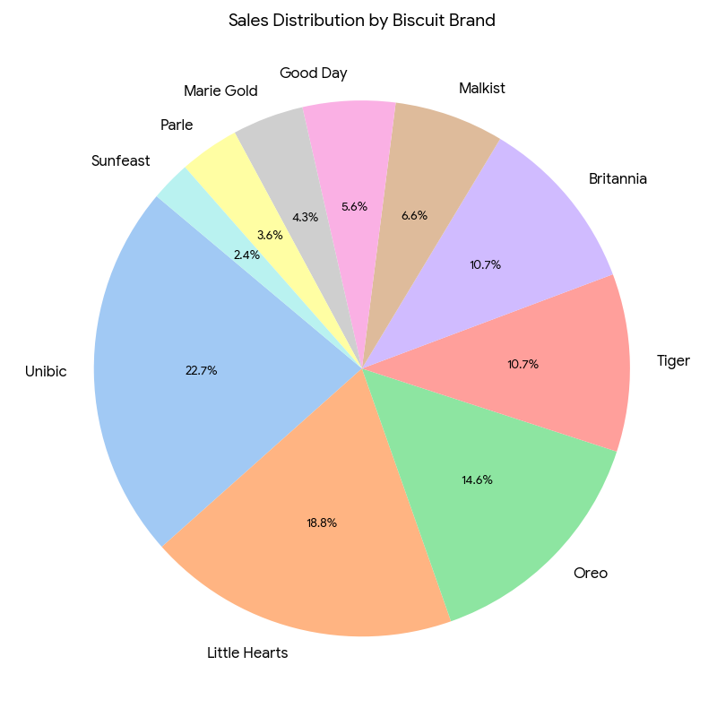
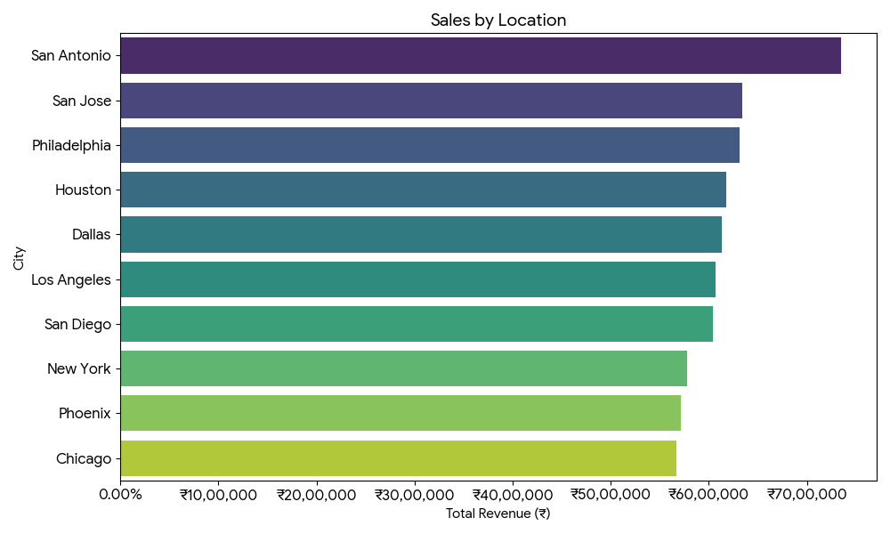
Sales Distribution

Slide 8
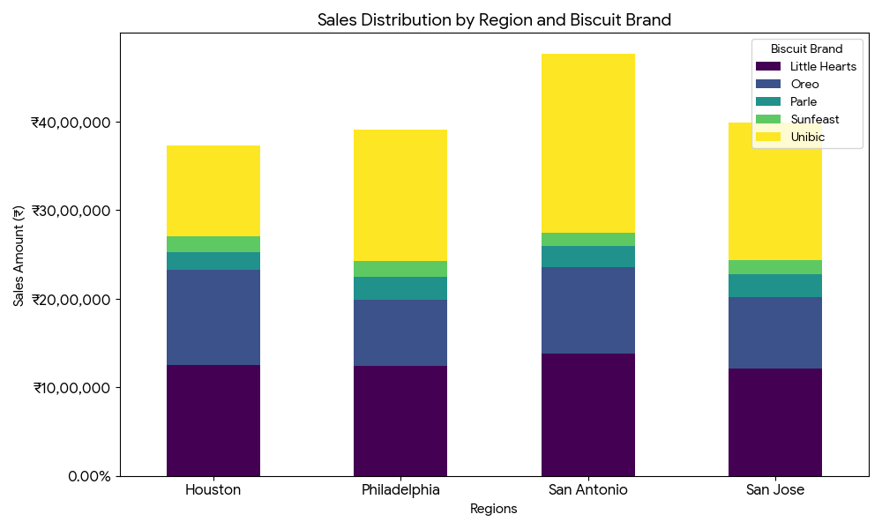
Sales Distribution by Region and Biscuit Brand

Slide 9
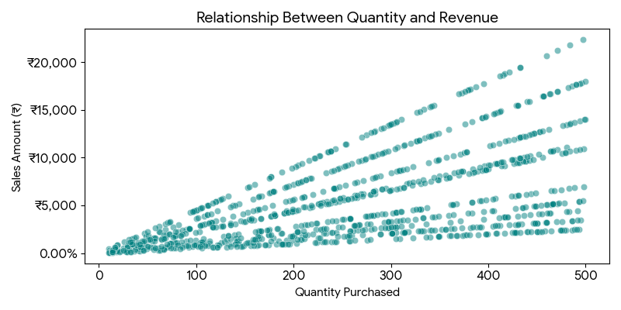
Relationship Between Quantity and Sales Amount

Slide 10
Raw Document: Profit Margin Overview
Transaction Date | Location | Biscuit Brand | Total Revenue | Profit | Profit Margin %
2024-01-04 | Los Angeles | Unibic | ₹22,500 | ₹17,500 | 77.78%
2024-09-15 | Los Angeles | Unibic | ₹22,500 | ₹17,500 | 77.78%
2024-04-15 | Dallas | Unibic | ₹22,500 | ₹17,500 | 77.78%
2024-07-30 | Philadelphia | Unibic | ₹22,500 | ₹17,500 | 77.78%
2024-07-19 | Los Angeles | Unibic | ₹22,500 | ₹17,500 | 77.78%
2024-07-18 | San Diego | Unibic | ₹22,410 | ₹17,430 | 77.78%
2024-05-18 | Dallas | Unibic | ₹22,365 | ₹17,395 | 77.78%
2024-01-16 | Philadelphia | Unibic | ₹22,365 | ₹17,395 | 77.78%
2024-02-06 | Philadelphia | Unibic | ₹22,365 | ₹17,395 | 77.78%

Slide 11
Sales & Profit Overview
KEY METRICS (2024)
• Total Sales: ₹6,15,67,883
• Total Profit: ₹2,67,84,833
• Average Profit Margin: 34.7%
• Average Discount: N/A

Slide 12
Dashboard Summary & Project Data
Project Summary & Insights:
• Unibic and Little Hearts dominate sales, accounting for over ₹2,50,00,000 in total revenue.
• Top geographic markets include San Antonio and San Jose, which consistently yield high margins.
Access the Interactive Dashboard & Raw Data:
Biscuit_Sales_Analysis.xlsx

